Slide 1
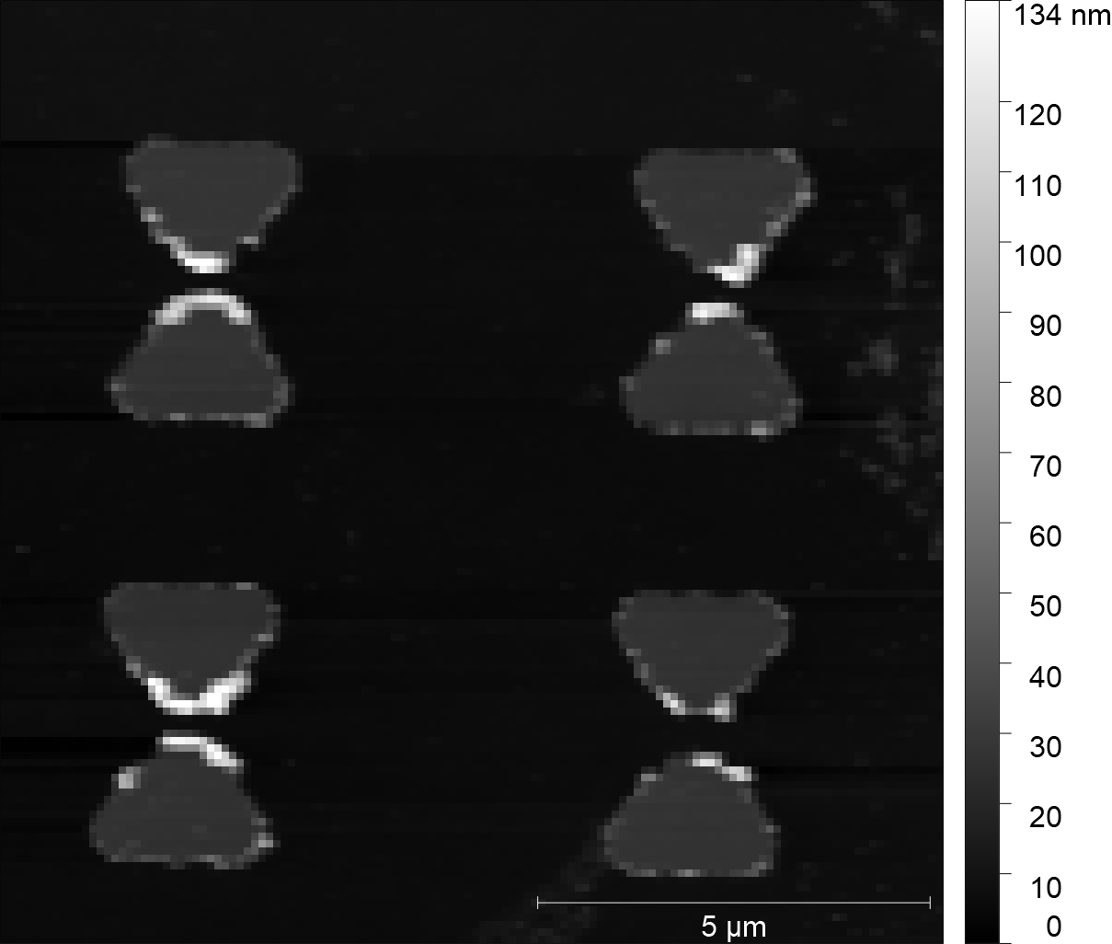
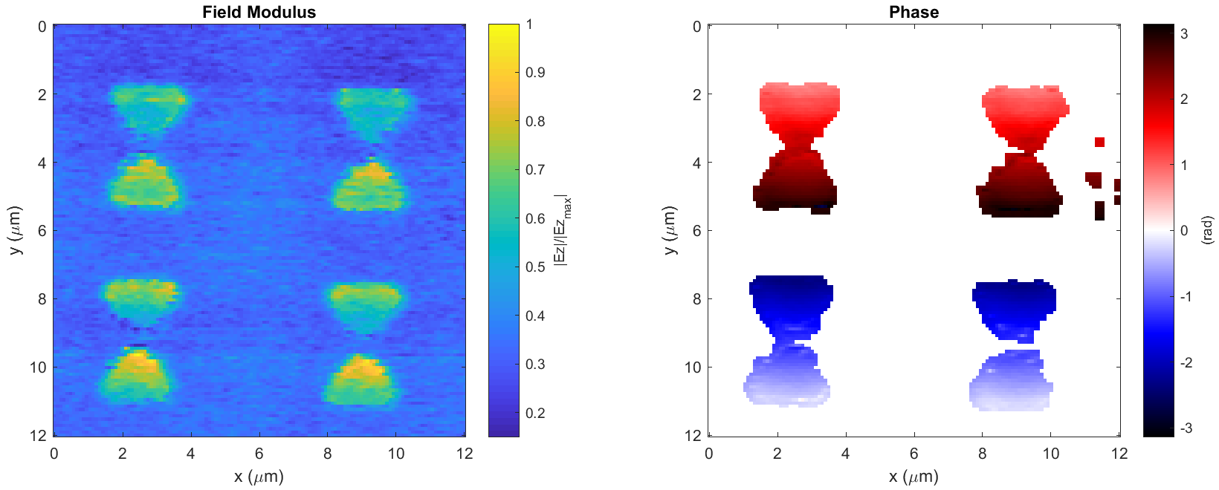
Classical Bowtie (BT) – Vertical Pol (2018-04-24_bowtie_1_VLP_PH_X_7)

Slide 2
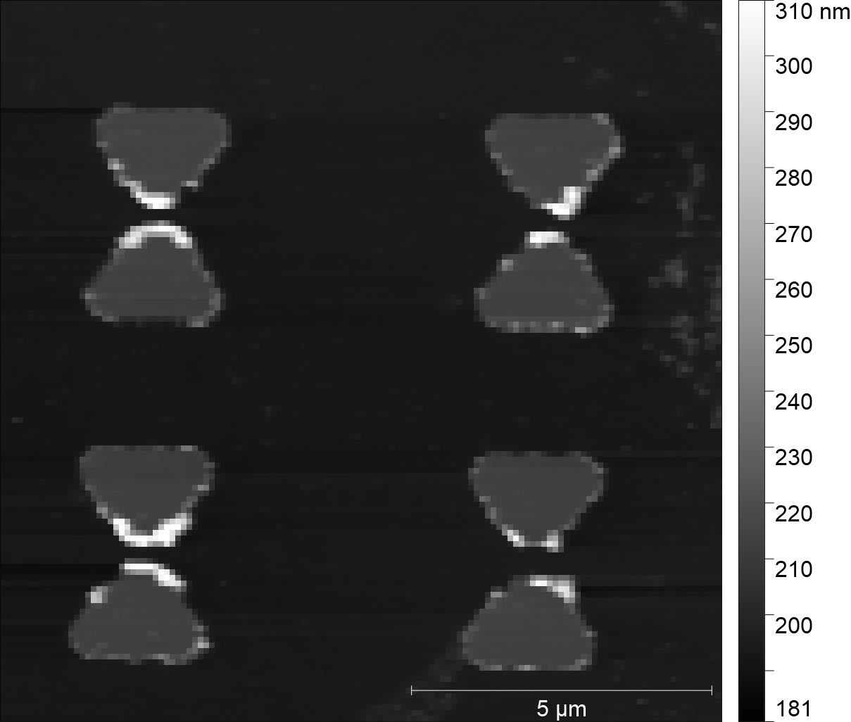
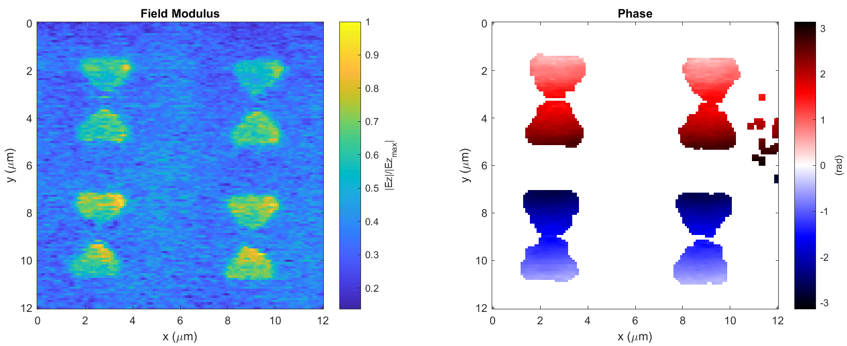
Classical Bowtie (BT) – Pol at 45 (2018-04-27_bowtie_1_LP_150_PH_X_3)

Slide 3
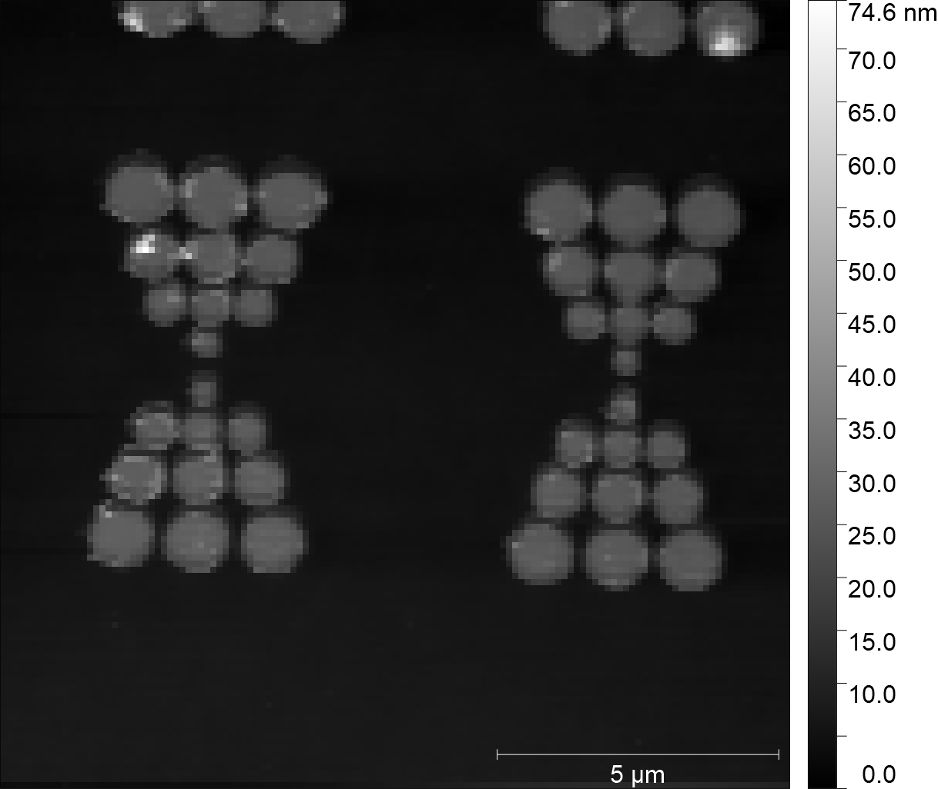
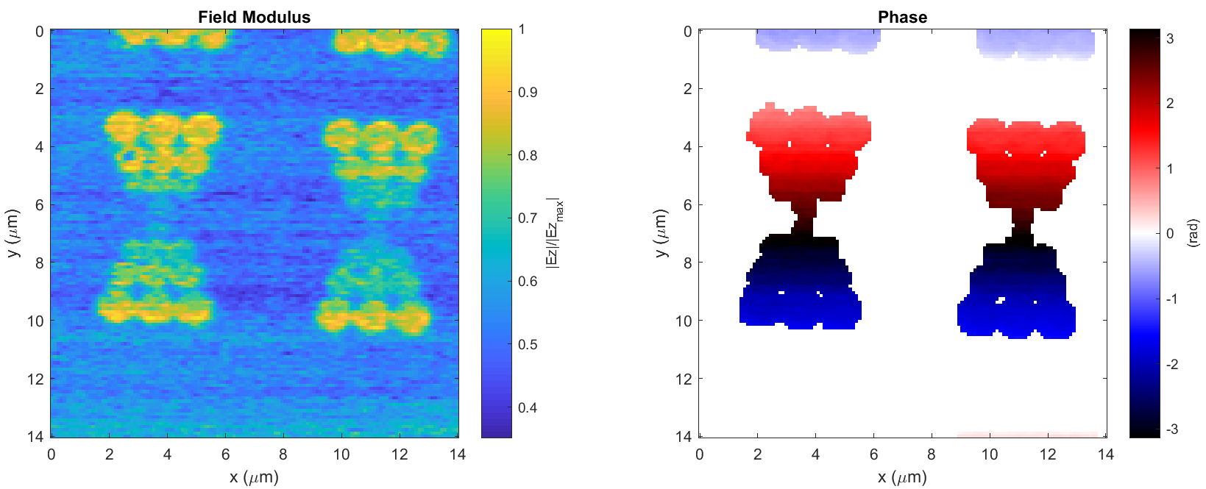
Discrete Bowtie (BT) – Vertical Pol (2018-04-27_discrete_bowtie_LP_90_PH_X_3)

Slide 4
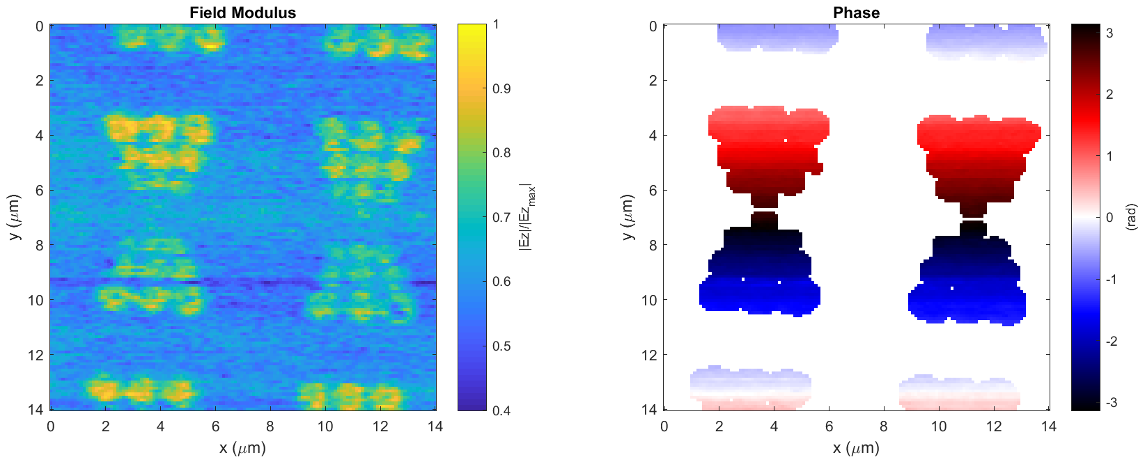
Discrete Bowtie (BT) – Pol at 45 (discrete_bowtie_1_LP_150_PH_X_3)

Slide 5
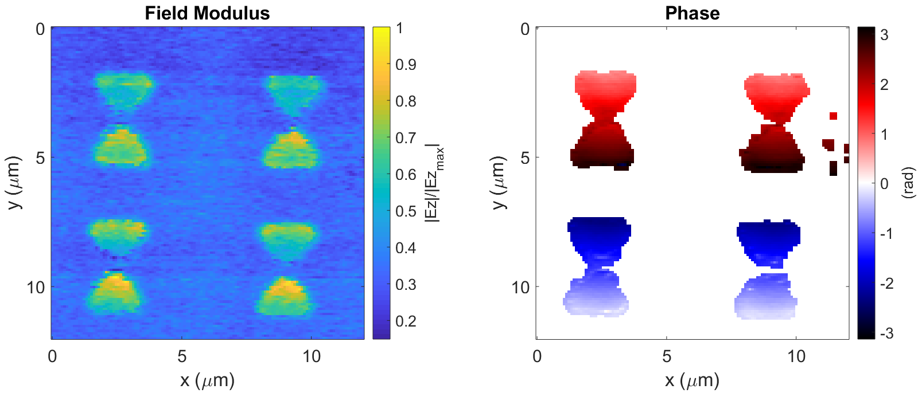
b)
c)
a)
d)
e)
g)
h)
f)
i)
j)

